Slide 1

Comparisons between detection algorithms
Project report

Slide 2
Project members
Name | ID
Omar wael saad eldwakhly | 1804197
Abdelrhman Mostafa Rifaat | 1805551

Slide 3
Introduction
In this modern evolutionary day and time, machine learning is the most popular and upcoming fields to the new times. The basics today shall become the roots for the greater technology coming in the future. The simple algorithms today, evolving, will design greater technologies tomorrow. Image classification or object detection falls under a wide scope of progress. Object detection is basically detection of a particular face or an object in a larger image or a video frame. Object detection has seen a major revolutionary change in the computer vision field. It helps us figure out which category does the object fall under

Slide 4
1.YOLO YOU ONLY LOOK ONCE
YOLO is the latest algorithm in the domain of object detection
It is the best in terms of speed and accuracy together when it comes to training big datasets
YOLO applies a single neural network to the full image
divides the image into regions and predicts bounding boxes and probabilities for each region
YOLO divides the frame in a number of grid and then it tries to detect the object in the particular grid
It uses a Non-max suppression filter to keep only the most dominating bounding boxes in a particular grid and hence gives most optimum results

Slide 5
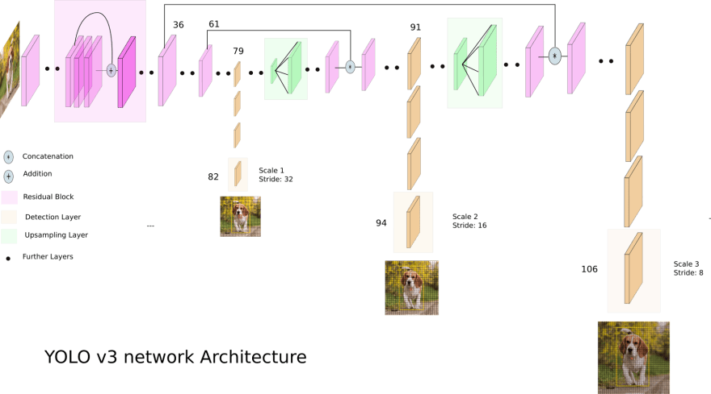
YOLO v3 Architecture

Slide 6
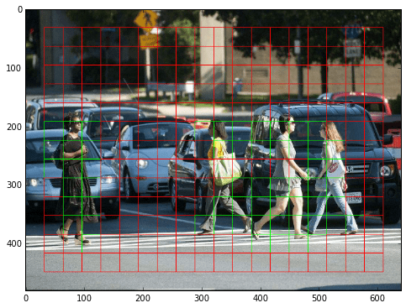
Residual blocks
First, the image is divided into various grids. Each grid has a dimension of S x S. The following image shows how an input image is divided into grids.
there are many grid cells of equal dimension. Every grid cell will detect objects that appear within them. For example, if an object center appears within a certain grid cell, then this cell will be responsible for detecting it.

Slide 7
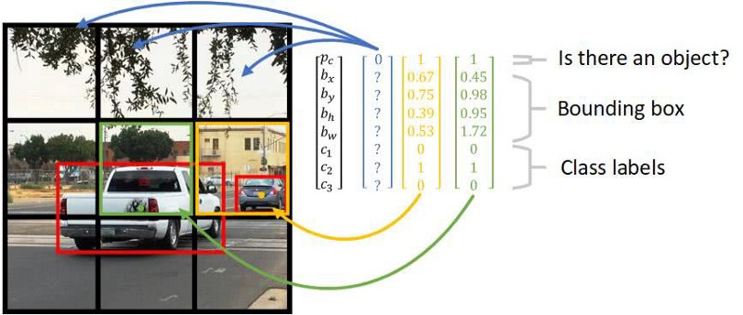
CNN Vector

Slide 8
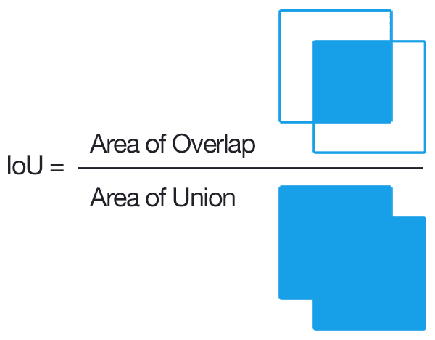
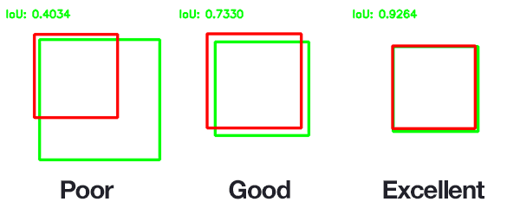
Intersection over union(IOU)
The higher the IoU, the better the performance.
It helps us remove duplicate bounding boxes for the same object.
we sort all the predictions/objects in descending order of their confidence.
If two bounding boxes are pointing to the same object, their IoU would be very high. In this case, we choose the box with higher confidence and reject the second one.
If the IoU is very low, this would possibly mean that the two boxes point to different objects of the same class.

Slide 9
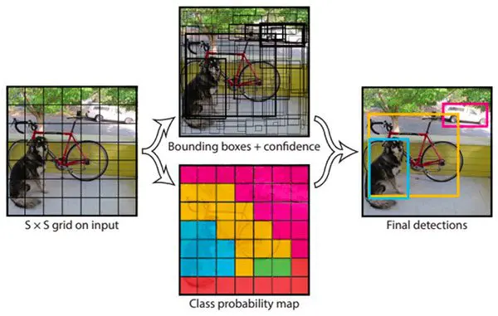
Non Maximal Suppression
In Non Maximal Suppression, YOLO suppresses all bounding boxes that have lower probability scores.

Slide 10
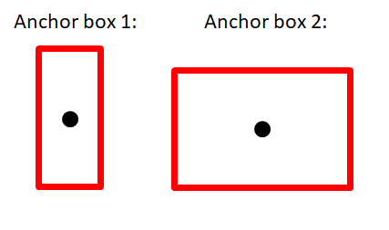
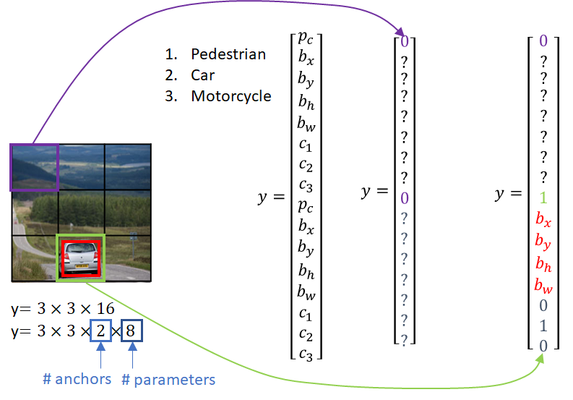
Anchor boxes
If more than one object in the same cell use anchor boxes

Slide 11
Pros And Cons of YOLO
PROS | CONS
The biggest advantage of YOLO is its amazing speed, it has a processing rate of 45 frames per second | Comparatively low more localization error compared to Faster R_CNN.
No sliding window | Struggles to detect small objects.
2 Anchors to detect two objects | Struggles to detect close objects because each grid can propose only 2 bounding boxes.

Slide 12
2.R-CNN Region Based CNN
As seen in the models before R-CNN the algorithms used a huge number of regions but here that problem is resolved. In R-CNN it takes only 2000 regions from the whole image which is called image proposal. Now instead of distinguishing large number of different regions we work with a limited 2000 regions.

Slide 13
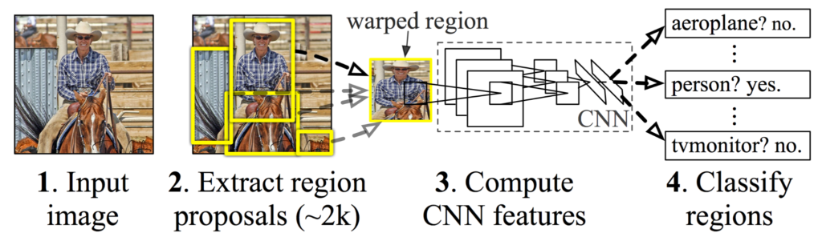
How it works
An input image goes through a mechanism called selective search to extract information about the region of interest.
Region of interest can be represented by the rectangle boundaries. Depending on the scenario there can be over 2000 regions of interest.
This region of interest goes through CNN to produce output features.
These output features then go through the SVM(support vector machine) classifier to classify the objects.

Slide 14

Problem
RCNN is slow in training and testing because of 2000 region.

Slide 15
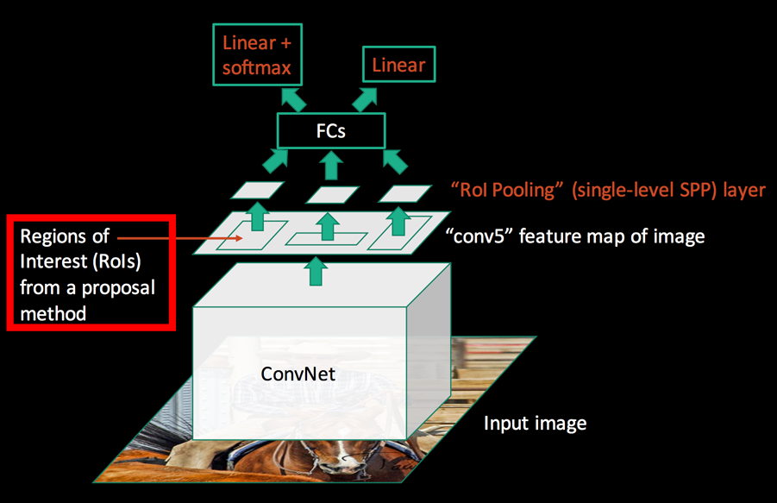
3.FAST RCNN
Basic R-CNN is very slow in training and testing because 2000 regions need to be calculated to complete the process and each region goes through the CNN where it takes a lot of time to extract the feature.
In Fast RCNN instead of working on the 2000 region to convert them into feature maps, it converts the whole image on the feature map mat once.

Slide 16
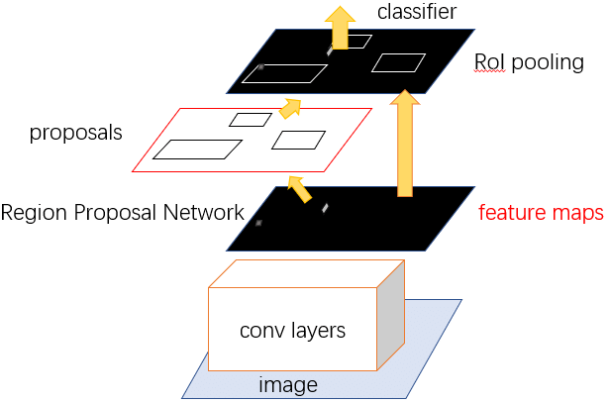
4.Faster-RCNN
Both of the above algorithms(R-CNN & Fast R-CNN) uses selective search to find out the region proposals. Selective search is a slow and time-consuming process affecting the performance of the network.
Faster R-CNN possesses an extra CNN for gaining the regional proposal, which we call the regional proposal network.
In the training region, the proposal network takes the feature map as input and outputs region proposals. And these proposals go to the ROI pooling layer for further procedure.

Slide 17
Difference between 3 detectors
 | R-CNN | Fast R-CNN | Faster R-CNN
region proposals method | Selective search | Selective search | Region proposal network
Prediction timing | 40-50 sec | 2 seconds | 0.2 seconds
computation | High computation time | High computation time | Low computation time
The mAP on Pascal VOC 2007 test dataset(%) | 58.5 | 66.9 (when trained with VOC 2007 only) 70.0 (when trained with VOC 2007 and 2012 both) | 69.9(when trained with VOC 2007 only)
The mAP on Pascal VOC 2012 test dataset (%) | 53.3 | 65.7 (when trained with VOC 2012 only) 68.4 (when trained with VOC 2007 and 2012 both) | 67.0(when trained with VOC 2012 only) 70.4 (when trained with VOC 2007 and 2012 both) 75.9(when trained with VOC 2007 and 2012 and COCO)

Slide 18
Conclusion
In the paper we successfully understand about four different object detection algorithms. Along with that we get to know basic pros and cons of a particular algorithm. This will help the reader to not only choose well a model for his project but also help to learn about multiple other object detection algorithms. The paper gives subjective knowledge about all algorithms.

